Slide 1
INTRODUCTION TO C

Slide 2
  OBJECTIVE -1
  Why C language is so important?
  History of C language

Slide 3
Why C language is so important?
    Worth to know about C language
    — Oracle is written in C.
    — Core libraries of android are written in C
    — MySQL is written in C
    — Almost every device driver is written in C
    — Major part of web browser is written in C
    — Unix operating system is developed in C
    — C is the world's most popular programming language
    For students
    — C is important to build programming skills
    — C covers basic features of all programming language
    — Campus recruitment process
    — C is the most popular language for hardware dependent programming

Slide 4
History of C language
    Developer of BCPL (Martin Rechards)
    Basic Combined Programming Language
    1966

Slide 5
Developer of B language (Ken Thompson )
    1969
    Also developer of UNIX operaring system
    He also developed first master level chess called Belle in 1980.
    Belle was the first computer defined for the sole purpose of chess playing.
The machine was developed by Joe Condon (hardware) and Ken Thompson (software) at Bell Labs in the 1970s and 1980s

Slide 6
Developer of C language (Dennis Ritchi)
    In 1972
    At AT & T’s Bell Labs, USA
    Co-developer of UNIX operating system
    (Generally C language is made for making Unix OS)

Slide 7
Objective -2
Fundamental Terminology
What is Computer ?
    Computer is an electronic device that takes input, process it and gives output.
    Low current : Laptop, PC, Mobile, Servers, Calculator, Digital Computer etc.

Slide 8
What is 0 and 1 ?
    There is nothing like 0 and 1 in computer. There is no physical significance of 0 and 1
    Any information can be encoded as sequence of 0 and 1.

Slide 9
Different devices have represent 0 and 1 in different ways.
  Hardisk (in magnetic material using north 1 / south 0 pole)
  Hardrive stored data in magnetic media so they can save data without any current.
  (Non Volatile)
  RAM ( Charged hold in capacitor (Charge hold 0 or 1))
  Each banks of capacitor holds eight bits (1 byte)
  ( Volatile)
  Processor (contains Register ( which made with the help of flip flop) )
  Ex : 16 bit register mean register made by 16 flip flop( flip flop store 0 or 1 at a time Or 1 bit at a time)
  ( Volatile)

Slide 10
What is Hardware?
    Hardware is a comprehensive term for all of the physical parts of a computer, as distinguished from the data it contains or operates on, and the software that provides instructions for the hardware to accomplish tasks.
    Hardware is anything which is tangible(touchable)

Slide 11
What is file ?
    File Name
    File Extension
    Example : Track01.mp3, vedio.mp4, DSC1.jpg, list.txt, sum.exe
    All represent in 0 - 1 form.

Slide 12
What is Software ?
    Application Software (Useful for user)
    System Software (Useful for Machine)

Slide 13
Program and Process
    Set of instruction is called Program
    Active state of program is called Process

Slide 14
Operating System
    It is a system software
    Examples are DOS, windows xp, windows vista, windows 7 windows 8, Solaris, Macintosh, Linux, ubuntu etc
    It provides interface between user and machine
    Acts as a manager of the computer system
    It does process management, memory management, file management.

Slide 15
Objective - 3
  Understanding Program’s execution
  How to create a software using C language

Slide 16
Dynamic random-access memory (DRAM)
Dynamic random-access memory (DRAM) is a type of random-access memory that stores each bit of data in a separate capacitor within an integrated circuit. The capacitor can be either charged or discharged; these two states are taken to represent the two values of a bit, conventionally called 0 and 1.

Slide 17
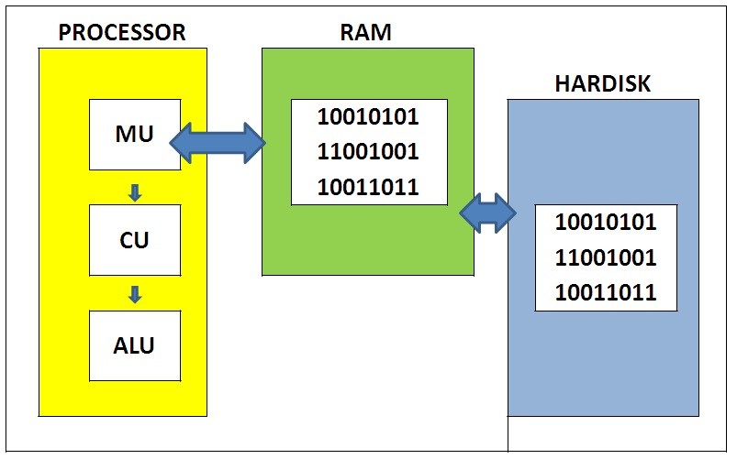
Understanding Program’s execution
    MU (MEMORY UNIT) : SET OF REGISTERS (EX : 16 BITS)
    CU (CONTROL UNIT) : CIRCUIT THAT READS INSTRUCTION AND DECODE IT
    ALU (ARITHMETIC LOGICAL UNIT) : RESPONSIBLE FOR ALL ARITHMETIC AND LOGICAL CALCULATION

Slide 18
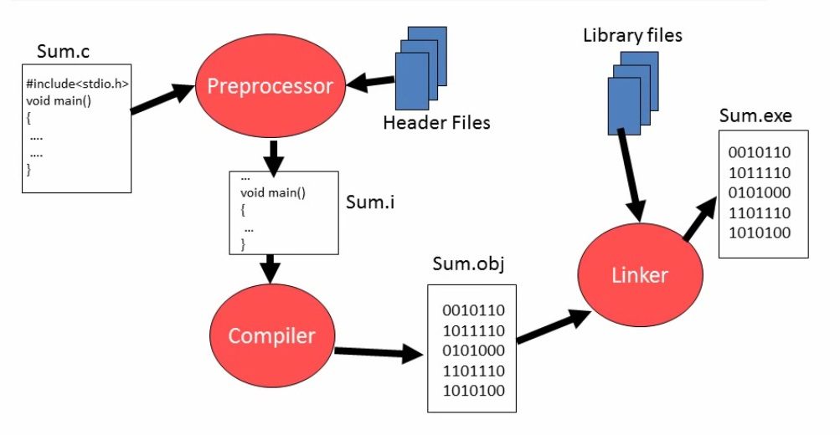
SOFTWARE DEVELOPMENT IN C
    Developer DELIVER ONLY a SUM.EXE Files

Slide 19
WHAT IS PREPROCESSOR, COMPILER, ASSEMBLER, LINK EDITOR

Slide 20
The Preprocessor
The Preprocessor accepts source code as input and is responsible for
  removing comments
  interpreting special preprocessor directives denoted by #.

Slide 21
For example
#include — includes contents of a named file. Files usually called headerfiles. e.g
  #include <math.h> — standard library maths file.
  #include <stdio.h> — standard library I/O file
#define — defines a symbolic name or constant. Macro substitution.
  #define MAX_ARRAY_SIZE 100

Slide 22
C Compiler
The C compiler translates source to assembly code. The source code is received from the preprocessor.

Slide 23
Assembler
The assembler creates object code. In MSDOS these are object code files(.obj).

Slide 24
Link Editor
If a source file references library functions or functions defined in other source files the link editor combines these functions (with main()) to create an executable file. External Variable references resolved here also.

Slide 25
Objective : 4
  The C Character Set
  Escape Sequences
  Delimeters
  The C Keywords
  Identifier
  Constant

Slide 26
The C Character Set
1) Letters
    A to Z in Capital letters.
    a to z in Small letters.
2) Digits
    All Decimal 0 to 9

Slide 27
3) White Spaces
In computer programming, white space is any character or series of characters that represent horizontal or vertical space in typography. A whitespace character does not correspond to a visible mark, but typically does occupy an area on a page.
IMP: The main use is to seperate the data from buffer or different type of data from buffer.
For example, the common whitespace
Blank Space
Horizontal tab
Vertical tab
New line
Form feed
Uses :when we Enter the multiple data on Output screen. We press Enter , Tab ,Space etc. for Perform somet task on our inputed data.

Slide 28
4) Special Characters
Symbol | Meaning | Symbol | Meaning
~ | Tilde | ` | Apostrophe
! | Exclamation mark | - | Minus sign
# | Number sign | = | Equal to sign
$ | Dollar sign | { | Left brace
% | Percent sign | } | Right brace
^ | Caret | [ | Left bracket
& | Ampersand | ] | Right bracket
* | Asterisk | : | Colon
( | Left parenthesis | " | Quotation mark
) | Right parenthesis | ; | Semicolon
_ | Underscore | < | Opening angle bracket
+ | Plus sign | > | Closing angle bracket
| | Vertical bar | ? | Question mark
\ | Backslash | , | Comma
` | Apostrophe | . | Period
- | Minus sign | / | Slash

Slide 29
Escape Sequences
Many programming languages support a concept called Escape Sequence. When a character is preceded by a backslash (\), it is called an escape sequence and it has a special meaning to the compiler. For example, \n in the following statement is a valid character and it is called a new line character −

Slide 30
    The following table lists the escape sequences available in C programming language −
Escape Sequence | Description
\t | Inserts a tab in the text at this point.
\b | Inserts a backspace in the text at this point.
\n | Inserts a newline in the text at this point.
\r | Inserts a carriage return in the text at this point. use \r to move to the start of the line and overwrite the existing text.
\f | Inserts a form feed in the text at this point. \f is used for page break. You cannot see any effect in the console. But when you use this character constant in your file then you can see the difference. (in cmd abc > xyz.doc)
\' | Inserts a single quote character in the text at this point.
\" | Inserts a double quote character in the text at this point.
\0 | Insert null character ( end of string)
\\ | Inserts a backslash character in the text at this point.

Slide 31
Delimeters
    Language pattern of C uses special kind of symbols, which are called as delimeters.
    They are given as under.
Delimiters | Symbols | Use
Colon | : | Useful for label (in switch and goto)
Semicolon | ; | Terminates statements
Parenthesis | () | Used in Expression and function,condition
Square brackets | [] | Used for array declaration
Curly braces | {} | Scope of statement
Hash | # | Preprocessor directive
Comma | , | Variable seperator
Null Character | \0 | In end of string

Slide 32
Keywords
    Keywords are the reserved words in programming. As C is a case sensitive language, all keywords must be written in lowercase. Here is a list of all keywords allowed in ANSI C.
    Generally in TC they all are seen in white color ( 32 in TC old versions)
Keywords in C Language
auto | double | int | struct
break | else | long | switch
case | enum | register | typedef
char | extern | return | union
continue | for | signed | void
do | if | static | while
default | goto | sizeof | volatile
const | float | short | unsigned

Slide 33
IDENTIFIER
    Identifiers are the names you can give to entities such as variables, functions, array ,structures etc.
    Also remember, identifier names must be different from keywords. You cannot use int as an identifier because int is a keyword.
    Ex:
    int money;
    double accountBalance;
    Identifier is like a word
    Instruction is like a sentence

Slide 34
Constant
    Any information is Constant
    Data = Constant = Information

Slide 35
Types of Constants
Primary
    Integer (2, -34 , 0)
    Real (3.4 , 0.06 )
    Character ( Single quote, lenghth one)
Secondary (Secondary constant made with the help of primary constant)
    Array
    String ( e.g “Rahul” )
    Pointer
    Union
    Structure
    Enumerator
    Class

Slide 36
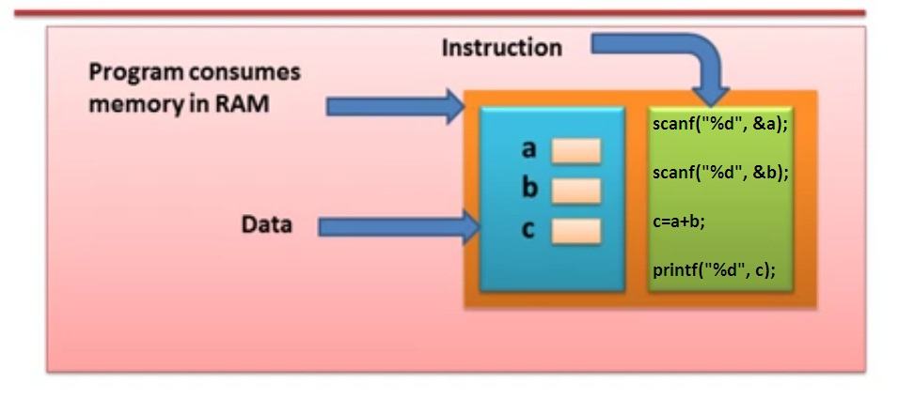
Process Memory
Variable are the names of memory locations where we store data. (We will learn later )

Slide 37
Objective :5
  Variable
  Data Types
  Declaration Different Types of Variable
  Operator and Expressions

Slide 38
Variable
A variable is a name that may be used to store a data value. Unlike constant, variables are changeable, we can change value of a variable during execution of a program. A programmer can choose a meaningful variable name. Example : average, height, age, total etc.
Rules to define variable name
Variable name must be upto 8 characters.
Variable name must not start with a digit.
Variable name can consist of alphabets, digits and special symbols like underscore _.
Blank or spaces are not allowed in variable name.
Keywords are not allowed as variable name.
The Variable names may be a combination of uppercase and lowercase characters . Ex: suM and sum are not the same

Slide 39
Data types in C Language
Data types specify how we enter data into our programs and what type of data we enter. C language has some predefined set of data types to handle various kinds of data that we use in our program. These datatypes have different storage capacities.

Slide 40
Size and Range and Control Strings of Data type on 16-bit Compiler
Type | Size(bytes) | Range | Control String
char or signed char | 1 | -128 to 127 | %c
unsigned char | 1 | 0 to 255 | %c
int or signed int | 2 | -32,768 to 32767 | %i or %d
unsigned int | 2 | 0 to 65535 | %u
short int or signed short int | 1 | -128 to 127 | %d
long int or signed long int | 4 | -2,147,483,648 to 2,147,483,647 | %ld
unsigned long int | 4 | 0 to 4,294,967,295 | %lu
float | 4 | 3.4E-38 to 3.4E+38 | %f or %g
double | 8 | 1.7E-308 to 1.7E+308 | %lf
long double | 10 | 3.4E-4932 to 1.1E+4932 | %lf
void
void type means no value. This is usually used to specify the type of functions. We will learn it later
Note: C program takes 64 Kb memory in RAM on 16 - bit Compiler

Slide 41
  Declaration Different Types of Variable
The declaration of variables should be done in the declaration part of the program. The variables must be declared before they are used in the program.
Declaration provides two things
Compiler obtains the variable name
It tells to the compiler data types of the variable being declared and helps in allocating the memory.
The syntax of declaring a variable is as follows.
Syntax : Data_type variable_name
Example :
int age;
char m;
float s;
double k;
int a,b,c;
The int, char, float and double are the keywords to represent data types. Commas separate the variables, in case variables are more than one.

Slide 42
  Operator and Expressions
Operators, functions, value and variables are combined together to form expressions.
Consider the expression A + B * 5. where, +, * are operators, A, B are variables, 5 is value and A + B * 5 is an EXPRESSION.
The symbols which are used to perform logical and mathematical operations in a C program are called C OPERATORS.

Slide 43
C language offers many types of operators.
Types of Operator | Symbolic Representation
Arithmetic operators | + , - , * , / and %
Relational operators | > , < , = = , >= , <= and !=
Logical operators | && and ||
Increment and Decrement operator | ++ and --
Assignment Operator | =
Bitwise operators | & , | , ^ , >> , << and ~
Comma operator | ,
Conditional operator | ? :
Compound Statement Operator | += , -= ,*= , /= ,%= e.g int x=2; x+=5; O/p : x=7

Slide 44
Note:
If Logical AND (&&) Operator consist two condition like this e.g. if( 3>5 && 4<6)
If first condition is false then control doesn’t check second condition, skip it and go to next statement.
If Logical OR (||) Operator consist two condition like this e.g. if( 7>5 || 4<6)
If first condition is true then control doesn’t check second condition, skip it and go to next statement.

Slide 45
C – Basic Program
  A C program basically has the following form:
    Preprocessor Commands
    Functions
    Variables
    Statements & Expressions
    Comments
    #include <stdio.h>
    #include<conio.h>
    void main()
    {
    // Simple Hello Program
    /* My first program
    in C language */
    printf("Hello, World! \n");
    getch();
    }

Slide 46
Note the followings
    C is a case sensitive programming language. It means in C printf and Printf will have different meanings.
    C has a free-form line structure. End of each C statement must be marked with a semicolon.
    Multiple statements can be one the same line.
    White Spaces (ie. tab space and space bar ) are ignored.
    Statements can continue over multiple lines.
    Compilation start from first line code of header file (check line compiled by compiler)
    execution start at main() (note: without main execution is not done)

Slide 47
printf and scanf function in c programming
printf() and scanf() functions are inbuilt library function in C.
These functions are declared and related macros are defined in "stdio.h" which is a header file.

Slide 48
printf function
printf() is not a keyword
printf() is a predefined function
printf() function is used to print Two types of messages.
1 Printing text as it is.
  Syntax : printf(" Write Text Here" );
2 ) Printing the value of "character, string, float, integer, octal and hexadecimal values" and expressions value and function_return value onto the output screen.
  Syntax : printf("formate_specifier", variable_name/ functions_call/expression );

Slide 49
Use : format specifier
  %d : value of an integer variable
  %c : value of a character variable
  %f : value of a float variable
  %lf : value of a double variable
  %s : value of a string variable
  %o : octal value corresponding to integer variable
  %x :a hexadecimal value corresponding to integer variable
  % sign indicate to the Compiler that change the meaning of suffix.
  e.g : %d , change the meaning of d .
  Note:
  we can output more than one value of variable/ expressions /functions.

Slide 50
How to print %d using printf in C language
We Know that the meaning of % in C Language is to indicate to the Compiler that change the meaning of suffix.
e.g : %d , in this the meaning of d is changed .Now d work as control string or format specifier for the format Decimal value.
To print the %d on Output screen we use % sign as prefix with %d, e.g : %%d in this , first % change the meaning of % in %d and indicate to the compiler that % is just a printable symbol. Due to this % will not work as format specifier, because its meaning changed.
e.g : printf(“%%d”);
In this %%d , % is like a printable symbol.

Slide 51
scanf Function
scanf() is not a keyword
scanf() is a predefined function
scanf() function is used to read character, string, numeric data from keyboard.
syntax : scanf("format_specifier", variable_address)

Slide 52
Use : format specifier
%d : value of an integer variable
%c : value of a character variable
%f : value of a float variable
%lf : value of a double variable
%s : value of a string variable
%o : octal value corresponding to integer variable
%x :a hexadecimal value corresponding to integer variable
Note:
we can input more than one value
space not allow after or before format specifier in scanf.

Slide 53
Control Instruction
Decision Control Instruction
Iterative Control Instruction
Switch Case Control Instruction
goto control Instruction

Slide 54
Decision Control Instruction
if
if else
nested if...else statement
else if ladder ( if...else if...else Statement )
Conditional Operator ( ? :)
// Ternary Operator(consist 3 arguments)

Slide 55
1) if Statement
Syntax for the simplest if statement
if(condition) /* no semi-colon , not a function */
{
Statement1;
Statement2;
}
The statement or instruction is executed only when the condition is true. In case the condition is false the compiler skips the lines within the block (Curly braces).

Slide 56
Note:
The conditional statements should not be terminated with semi-colon(;).
Curly braces indicate the scope of the if statement, default scope is one statement.
Other than 0(zero), all other values are considered as true.
EX: if(27)
printf("hello");
We can write action statement in condition block of decision statement without semicolon .

Slide 57
2) if else Statement
Syntax for the simplest if statement
if(condition) /* no semi-colon , not a function */
{
Statement 1;
Statement 2;
}
else
{
statement 3;
}
The if ..else statement takes care of true as well as false conditions. It has two blocks. One block is for if and it is executed when the condition is true. The other blocks is of else and it is executed when the condition is false.

Slide 58
Note:
The else statement cannot used without if,
No multiple else statement are allowed with one if.

Slide 59
3) nested if...else statement
Syntax :
if( condition )
{
if(condition )
{
statement block1;
}
else
{
statement block2;
}
}
else
{
statement block3;
}

Slide 60
4) else if ladder ( if...else if....else Statement )
Syntax :
if (condition)
{
statement1;
}
else if (condition)
{
statement2;
}
else
{
statement3;
}

Slide 61
If we are having different – different test conditions with different – different statements, then for these kind of programming we need else if ladder.
Note:
Else if the leader is not interdependent to any other statements or any other test conditions. But in nested if else statements depends to any other.

Slide 62
Conditional Operator ( ? :)
Syntax
condition ? statement1 : statement2;
e.g : a>b ? printf(“a is greater”) : printf(“ b is greater”);
Two Statement are separated by a colon. If the condition is true statement1 is executed otherwise statement2 executed.
Another use : selective assignment
e.g : max= a>b ? x : y ;
Note : condition is always written before ? mark.

Slide 63
Iterative Control Instruction/Loop Control Statement
A loop is defined as a block of statements which are repeatedly executed for certain number of times.
C language support three types of loop control statements.
  for
  while
  do while

Slide 64
The for LOOP
The for loop allows to execute a set of instruction until a certain condition is satisfied. Condition may be predefined or open ended.
Syntax :
for( initialize ; condition ; incre / decre)
{
Statement 1;
Statement 2;
}

Slide 65
Various Formats of ‘for’ loop
Syntax | Output | Remark
for( ; ; ) | Infinite loop | No arguments
for( a=0; a<=20;) | Infinite loop | ‘a’ is neither increased nor decreased
for(a=0; a<=10; a++) printf(“%d”, a) | Display value from 1 to 10 | ‘a’ is increased from 0 to 10.

Slide 66
Note:
In for loop we have exactly two semicolons, one after initialization and second after condition. In this loop we can have more than one initialization or increment/decrement, separated using comma operator. for loop can have only one condition.
Please note that the variables which are declared, should be of same type

Slide 67
Nested for loop
We can also have nested for loops, i.e one for loop inside another for loop.
Basic syntax is,
for(initialization; condition; increment/decrement)
{
for(initialization; condition; increment/decrement)
{
statement ;
}
}

Slide 68
while loop
while loop can be addressed as an entry control loop. It is completed in 3 steps.
  Variable initialization.( e.g int x=0; )
  condition( e.g while( x<=10) )
  Variable increment or decrement ( x++ or x-- or x=x+2 )
Syntax :
variable initialization ;
while (condition)
{
statements ;
variable increment or decrement ;
}

Slide 69
do while loop
In some situations it is necessary to execute body of the loop before testing the condition. Such situations can be handled with the help of do-while loop. do statement evaluates the body of the loop first and at the end, the condition is checked using while statement.
Syntax of do-while loop is,
variable initialization;
do
{
statements;
variable increment/decrement
}
while(condition) ;
Note:
When pass 0 in while loop considered as false. Other than 0(zero), all other values are considered as true(mean loop will be infinite).

Slide 70
Difference between while and do-while loop?
do-while loop is similar to while loop, however there is one basic difference between them – do-while runs at least one even if the test condition is false at first place.
"while" and "for" loop doesn't end with a semicolon, only the “do while” loop ends with a semicolon

Slide 71
Jumping Out of Loops
Sometimes, while executing a loop, it becomes necessary to skip a part of the loop or to leave the loop as soon as certain condition becomes true, that is called jumping out of loop. C language allows jumping from one statement to another within a loop as well as jumping out of the loop.

Slide 72
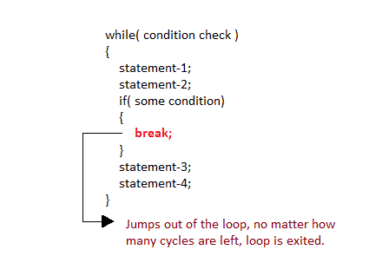
1) break statement
When break statement is encountered inside a loop, the loop is immediately exited and the program continues with the statement immediately following the loop.

Slide 73
// Program to calculate the sum of maximum of 10 numbers
// Calculates sum until user enters positive number
# include <stdio.h>
void main()
{
int i;
double number, sum = 0;
for(i=1; i <= 10; ++i)
{
printf("Enter a no. %d: ",i);
scanf("%lf",&number); // If user enters negative number, loop is terminated
if(number < 0.0)
{
break;
}
sum = sum + number;
}
printf("Sum = %.2lf",sum);
getch();
}

Slide 74
What will we do to break from outer loop.
Note: break; It break inner loop only.
We can use goto statement to terminate from the scope Or from outer loop.
Example 1 : Using break; in inner loop.
Example2 : Using goto label in inner loop.

Slide 75
Example 1: break use in inner loop.
#include<stdio.h>
#include<conio.h>
void main()
{
int i,j;
clrscr();
for(i=1;i<5;i++)
{
for(j=1;j<5;j++)
{
if(i==2)
break;
printf("i is %dand j is %d\n",i,j);
}
}
getch();
}

Slide 76
Example 2: goto statement use to terminataion from outer loop.
#include<stdio.h>
#include<conio.h>
void main()
{
int i,j;
clrscr();
Outer_loop :
for(i=1;i<5;i++)
{
Inner_loop:
for(j=1;j<5;j++)
{
if(i==2)
// break Outer_loop; //this is line 14
break;
printf("i is %dand j is %d\n",i,j);
}
}
getch();
}

Slide 77
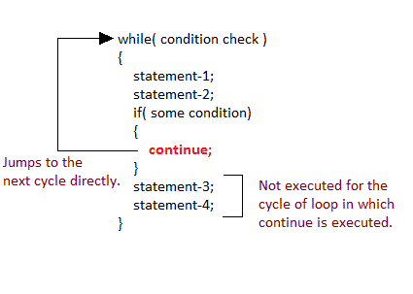
2) continue statement
It causes the control to go directly to the test-condition and then continue the loop process. On encountering continue, cursor leave the current cycle of loop, and starts with the next cycle.
Other word : It will skip the instruction when condition meet.
It skips inner loop when the condition is meet.It doesn’t skip outer loop.
To skip from outer loop we can use goto statement.

Slide 78
// Program to calculate sum of maximum of 10 numbers
// Negative numbers are skipped from calculation
# include <stdio.h>
void main()
{
int i;
double number, sum = 0.0;
for(i=1; i <= 10; ++i)
{
printf("Enter a n%d: ",i);
scanf("%lf",&number); // If user enters negative number, loop is terminated
if(number < 0.0)
{
continue;
}
sum = sum + number;
}
printf("Sum = %.2lf",sum);
getch();
}

Slide 79
Difference between break and continue.
Break | Continue
Exits from current block or loop. | Loop takes next iteration.
Control passes to next statement | Control passes at the beginning of loop.
Terminates the program | Never terminates the program

Slide 80
Switch statement
Switch statement is used to solve multiple option type problems for menu like program, where one value is associated with each option. The expression in switch case evaluates to return an integral-value/character-value, which is then compared to the values in different cases, where it matches that block of code is executed, if there is no match, then default block is executed.

Slide 81
The general form of switch statement is,
switch(expression)
{
case value-1:
block-1;
break;
case value-2:
block-2;
break;
case value-3:
block-3;
break;
case value-4:
block-4;
break;
default:
default-block;
break;
}

Slide 82
Points to Remember
We don't use those expressions to evaluate switch case, which may return floating point values or strings.
It isn't necessary to use break after each block, but if you do not use it, all the consecutive block of codes will get executed after the matching block
scope{} can be use with cases. But not necessary .
default case can be placed anywhere in the switch case. Even if we don't include the default case switch statement works.

Slide 83
The goto Statement
This statement does not require any condition. This statement passes control anywhere in the program. i.e. control is transferred to another part of the program without testing any condition.
Syntax:
goto label ;
label :
statement;
Note:
  Where the label name must start with any character.
  Where label is the position where the control is to be transferred
  Imp use is to terminate from inner loop as well as outer loop also.

Slide 84
Differences between break and exit() in C
  The major difference between break and exit() is that break is a keyword, which causes an immediate exit from the switch or loop (for, while or do), while exit() is a standard library function, which terminates entire program execution when it is called.
  No header files needs to be included in order to use break statement in a C program. stdlib.h needs to be included in order to use exit() (Depend on compiler).
  break is a program control statement which is used to alter the flow of control upon a specified conditions.

Slide 85
Array
Array is a linear collection of similar elements. Array form an important part of almost all programming language. It provide a powerfulfeuture and can be used as or can be used to form complex data structures like stacks and queues.

Slide 86
One Dimensional Array
The one Dimensional array or single Dimensional array is the simplest type of array that contains only row for storing data. It has single set of square bracket[ ].

Slide 87
To declare single dimensional array, you can write the following code.
Example:
int a [ 5 ] ;
Where int is a data type of array.
‘a ‘ is name of array.
‘5’ is a number of elements in an array or size of array.

Slide 88
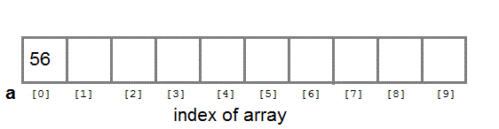
a [ 0 ] = 56 ;

Slide 89
Asssign statically value in an one dimensional array :
Example:
int a [ 5 ] = { 9, 6 ,8 , 3 , 2 }
OR
a [ 0 ] = 9 ;
a [ 1 ] = 6;
a [ 2 ] = 8 ;
a [ 3 ] = 3 ;
a [ 4 ] = 2 ;

Slide 90
Assign value through user in an one dimensional array
int a [ 1 ] ;
scanf ( “ %d ”, &a [ 0 ] ) ;
Note :
To storing and accessing the many no. of elements from one dimensional array you need to use loop in program.
The name of array contains base address of array. Ex : a

Slide 91
Declaration of Array
int a[ ] ; // error
int a[ 5 ] ; // no error
int a[ ] = { 9 , 6 , 8 , 0 , 2 } // by accessing over index than garbage value will return
int a[ 5 ] = { 9 , 6 , 8 , 0 , 2 } // no error
int a[ 5 ] = { 9 , 6 } // value 0 assign in remaining block
int a[ 2 ] ;
a[ 0 ]= 2 ; a[ 1 ]= 4 ; a [ 2 ]= 7 ; // No, error, you can also access extra initializer
int a[ 5 ] ;
a[ 0 ]= 9; // Garbage value assign in
OR assign value through user remaining block
int a[ 5 - 3] ; int a[ 5+1 ] ; int a[ 5%3 ] ;
int a[ 3/2 ] ; int a[ 5*2 ] ;

Slide 92
Two dimensional Arrays
C language supports multidimensional arrays. The simplest form of the multidimensional array is the two-dimensional array.

Slide 93
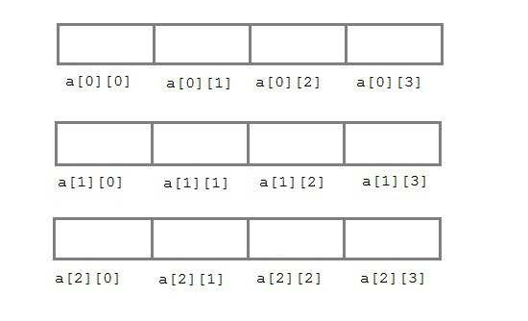
Two-dimensional array is declared as follows,
type array-name[row-size][column-size]
Example :
int a[3][4];

Slide 94
Asssign statically value in
Two Dimensional Array :
int arr[2][3] = { {0,0,0} , {1,1,1} };

Slide 95
Assign value through user in an array
int arr[3][4];
int i,j,k;
printf("Enter array element");
for(i=0;i<3;i++)
{
for(j=0; j < 4; j++)
{
scanf("%d",&arr[i][j]);
}
}

Slide 96
String
Sequence of character terminated at null character(space allow)
ASCII code of null character is 0 (zero)
Example:
  void main()
  {
  char s[10]={ ‘M’ , ’O’ , ’H’ , ’I’ , ’T’ , ’ \0 ’ } ;
  Or char s[10]={ “MOHIT”} ;
  int i ;
  for ( i=0 ; i <= 5 ; i++)
  printf ( “ %c ”, s [ i ] ) ;
  getch ( ) ;
  }
  Note:
  Null character doesn’t print on output screen.
  Null character is not a printable symbol.

Slide 97
Print String with loop
  void main ( )
  {
  char s[ 10 ] = { ‘S’ , ‘T’ , U‘’ , D‘’ , E‘’ , ‘N’ , ‘T’, ‘S’ , ‘\0’} ;
  int i ;
  for ( i=0 ; s[ i ]!= ‘\0’ ; i++)
  printf ( “%c” , s[ i ] ) ;
  getch () ;
  }

Slide 98
Print String without loop
  void main()
  {
  char s[ 10 ] = { ‘S’ , ‘T’ , U‘’ , D‘’ , E‘’ , ‘N’ , ‘T’, ‘S’ , ‘\0’} ;
  printf( “%s” , s ) ;
  // Or puts(s); accept space , newline , tab etc.
  }
  Note:
  we can also specify the precision with character string, which is to be displayed. The precision is (no. of character to be displayed ) provide after decimal point).
  e.g : printf ( “ %.5s”,s); // O/P : STUDE

Slide 99
Input string through user
Print String without loop
void main()
{
char s[ 20 ] ;
int i ;
printf( “ Enter your name ” ) ; // puts(s);
accept space , newline , tab
scanf ( “ %s ”, s ); // gets(s);
} accept space , newline , tab

Slide 100
Input string from user
    void main ()
    {
    char s [ 20 ] ;
    int I ;
    clrscr ( ) ;
    printf ( “ Enter your name ” ) ;
    scanf ( “%s” , s ) ; or scanf( “%s”, &s[0] );
    // gets ( s ); or gets ( &s[0]); // accept space, new line, tab
    printf( “%s” , s ); or printf( “%s” , &s[o] );
    // puts( s ); or puts( &s[0] ); // accept space, new line, tab
    getch ( );
    }

Slide 101
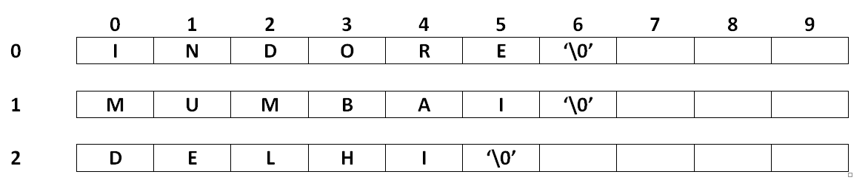
Handling Multiple Strings
Char s [3] [10] = { “ INDORE ” , “ MUMBAI ” , “ DELHI ”} ;

Slide 102
Handling Multiple String Through User
    void main( )
    {
    char s [ 3 ] [ 10 ] ;
    int i ;
    clrscr ( ) ;
    printf( “Enter Three Strings”) ;
    for ( i=0; i<=2; i ++ )
    //scanf( “%s ”, &s[i][0] ) ;
    gets(s[i]) ; // Or gets( &s[ i ] [0] ) ;
    for ( i=0; i<=2; i ++ )
    //printf ( “ %s \n ” , s[ i ] ) ;
    puts( s [ i ]) ; // Or puts(&s[i][0]);
    }

Slide 103
Some most useful String Handling Functions
The following are the most commonly used string handling functions. These functions are packaged in string.h library you must include string.h header file in your program to use these functions.
strlen() :It is used to show length of a string.
    Ex: int j ;
    j=strlen (“vivekanandgroup”);
    printf(“%d”, j) ;
    O/P : 15
strrev() : It is used to show reverse of a string.
    Ex: char name[10] = “Hello” ;
    printf(“%s” , strrev( name ) ) ;
    O/P : olleH

Slide 104
Continue…….
strlwr ( ) :
    Converts string to lowercase.
Strupr ( ) :
    Convert string to uppercase.
strcpy() :
    Copies one string into another
    Ex: char str1[10 ]={ “ Hello ” } ;
    Char str2[ 10 ] ;
strcpy ( str2 , str1 ) ;
    printf( “ str2 is %s ” , str2 );

Slide 105
continue….
strcmp ( ) :
    Ex: int j ;
    j= strcmp ( “study ”, “tonight”) ;
    printf( “ %d“ , j ) ;
    O/P : -1
strcat ( ) :It is used to concatenate two string.
    Ex: strcat( “hello”, “world “)
    strcat() function will add this string “ world ” to “ hello ”.

Slide 106
gets() and puts() function
Situation :
  Suppose we have list of students. And we need to enter their name. As normal no. of character in each name varies. So we can’t use looping for storing value in string because looping runs till string size.
  Similarly we want to enter space among different words, using normal input/ output function ( e.g printf, scanf ) its not possible.

Slide 107
Continue…
  If we want to enter a paragrapgh where we don’t know expected word length then formatted input function we can’t use.
  For this purpose we have following function.
    gets() for input
    puts() for output

Slide 108
gets() function :
We use this function for storing a string value in memory, using this we don’t need to use looping and this function does’nt bound us about memory.

Slide 109
puts() function :
It is used to display string on standard output devise, This function automatically insert a newline character at the end of each string it displays.

Slide 110
ASCII and Unicode
ASCII
  American standard code for Information Interchange. is a character encoding standard (the Internet Assigned Numbers Authority (IANA) prefers the name US-ASCII[2]). ASCII codes represent text in computers, telecommunications equipment, and other devices. Most modern character-encoding schemes are based on ASCII, although they support many additional characters.
    Alphanumeric character
    7 bits
    Total 128 characters
  Problem : cannot be used to represent all characters.(Other lang except english)

Slide 111
UNICODE
  Unicode provides a unique number for every character, no matter what the platform, no matter what the program, no matter what the language. The Unicode Standard has been adopted by such industry leaders as Apple, HP, IBM, JustSystems, Microsoft, Oracle, SAP, Sun, Sybase, Unisys and many others. Unicode is required by modern standards such as XML, Java, ECMAScript (JavaScript), LDAP, CORBA 3.0, WML, etc., and is the official way to implement ISO/IEC 10646. It is supported in many operating systems, all modern browsers, and many other products. The emergence of the Unicode Standard, and the availability of tools supporting it, are among the most significant recent global software technology trends.
  Unicode Consortium
  Represent all language
  16 bits
  65,000
  Used to represent all characters

Slide 112
Which one is better to use
  Unicode not efficient due to storage and transmission.
  Java mostly uses Ascii and uses Unicode for variable names, comments etc.

Slide 113
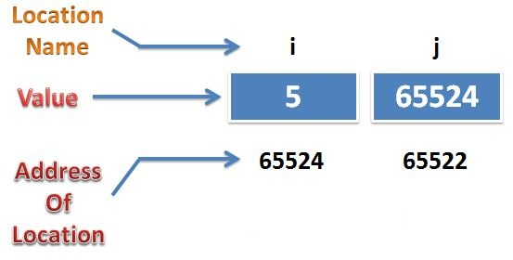
Pointer
Basic of Pointer
    Where
    i is an ordinary variable
    j is a pointer variable

Slide 114
continue….
    In the basis of DOS Base Architecture when C Program is RUN it takes 64 Kilobytes memory in RAM.
    64Kb = 65536 bytes ( 64 * 1024 = 65536 )
    This 65536 bytes assign no. 0 to 65535.
    This assign value is called : sequence no. or address (logical address

Slide 115
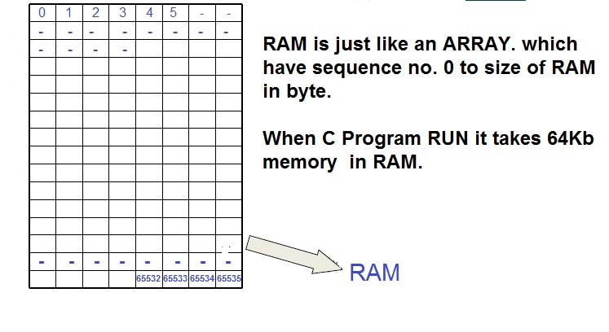

Slide 116
Continue…
Pointer is a variable that contains address of another variable of same data type.. ( e.g : ptr)
Pointer Variable (e.g : *ptr)
In C declaration if the variable name is preceded by asterisk or * then such a variable is called pointer variable.

Slide 117
Pointer Declaration :
int *ptr ;
  Where ptr is the name of variable. The * informs the compiler that we want a pointer variable. The int say that we are using pointer variable which will actually store the address of an integer value.
  Note:
    Pointer always use two bytes in memory.
    Always store the base address of variable.
    Pointer always point or store the address of block which have same type as pointer have.
    Pointer type should be necessary.

Slide 118
Remember :
    When put an ampersand (“&”) in front of a variable it will return address of that variable.
    When put an asterisk (“*”) in front of a address variable(&a or ptr) it will return value of that variable.
    Pointer always return containing address ( e.g : printf(“%u”,ptr); ).

Slide 119
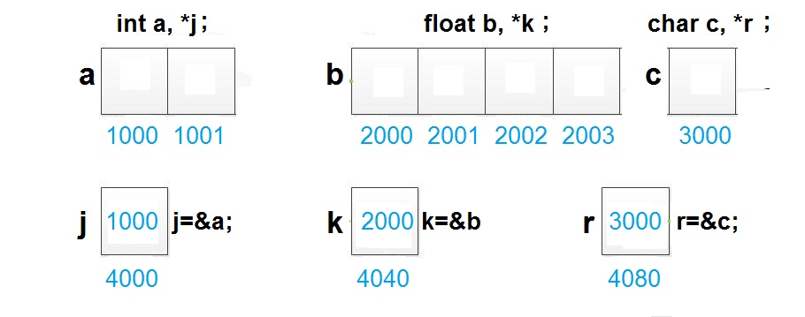
Base Address

Slide 120
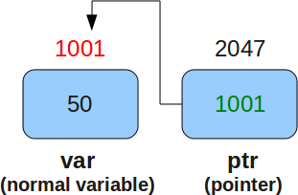
Example :
int var=50 , * ptr ;
ptr= &var ;

Slide 121
Example :
    main()
    {
    int var=50, *ptr , *p ;
    ptr= &var ;
    *p = 6 ;
    printf ( “ %d ”, var ) ; // 50
    printf ( “ %d ” , ptr ) ; // 1001
    printf ( “ %d ” , *ptr ) ; // 50
    printf ( “ %u ” , &var ) ; // 1001
    printf ( “ %u ” , &ptr ) ; // 2047
    printf ( “ %u ” , *&ptr) ; // 1001
    printf ( “ %d ” , *p ) ; // 6 (6 store at invalid address, wild pointer)
    printf ( “ %u ” , p ) ; // garbage address or invalid address
    }
    Note : Address always return with format string %u

Slide 122
Objective
Extendedd Concept of Pointers
Pointer’s Arithmetic
Application of Pointers

Slide 123
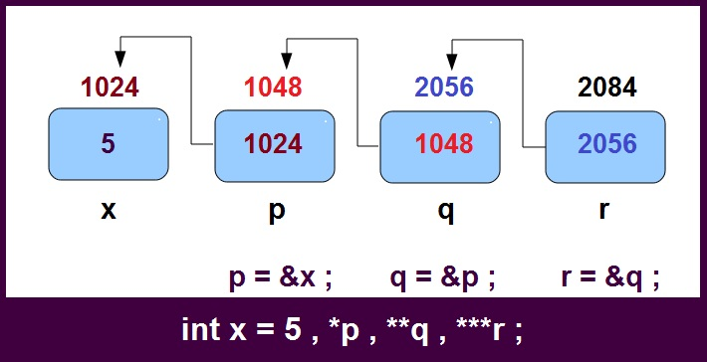
Extended Concept of pointers
    Note :
    Number of Asterisk (*) represent the level of pointer.
    “Always greater level of pointer contain/ hold the address of less than 1 level of pointer”

Slide 124
Example :
    void main ()
    {
    int x =5 , *p , **q , ***r ;
    p = &x ;
    q = &p ;
    r = &q ;
    printf ( “ %d ” , x ) ; // 5
    printf ( “ %u ” , p ) ; // 1024
    printf ( “ %u ” , q ) ; // 1048
    printf ( “ %u ” , r ) ; // 2056
    printf ( “ %d ” , *p ) ; // 5
    printf ( “ %d ” , **q ) ; // 5
    printf ( “ %d ” , ***r ) ; // 5
    getch ( );
    }

Slide 125
Pointer Arithmetic

Slide 126
We cannot add, multiply or divide two addresses
( Subtraction is Possible)
Example :
    void main()
    {
    int a, b , x, y, z ;
    int *p, *q ;
    p = &a ;
    q = &b ;
    x = p*q ;
    y = p / q ;
    z = p + q ;
    Or
    x = &a * &b ; // error
    y = &a / &b ; // error
    z = &a + &b ; // error
    }

Slide 127
We cannot multiply an integer to an address and similarly we cannot divide an address with an integer value.:
    Example :
    void main ()
    {
    int x, y, m, n ;
    float a, b ;
    float *p, *q ;
    p = &a ;
    q = &b ;
    x = p * 5 ; // &a * 5 ;
    y = q * 6 ; // &b * 6 ;
    m = p/2 ; // &a / 3 ;
    n = q / 3 ; // &b / 4 ;
    }

Slide 128
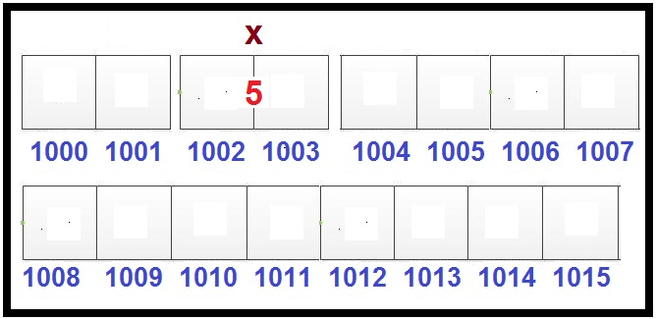
We can add or sub or subtract integer to an address ( return address)
    Example :
    int x , *p ;
    p = &x ;
    p + 1 ; // 1004 ( return next block base address of same type)
    p - 1 ; // 1001 ( return previous block address of same type)

Slide 129
Formulae :
Pointer + n = Pointer + sizeof (typeof pointer ) * n

Slide 130
    Example :
    void main()
    {
    int a , b ;
    int *p , *q ;
    p= &a ;
    q = &b ;
    p = p + 1 ; // p = p -1 ;
    q = q - 1 ; // q = q -1 ;
    }
    Note : they return address so must be store in pointer.

Slide 131
We can subtract to addresses of same type which have same level of pointer.
    Formulae :
    Pointer1 – Pointer2 = Literal Subtraction / sizeof( type of pointer)

Slide 132
    Example :
    #include<stdio.h>
    #include<conio.h>
    void main()
    {
    int x , y , z ;
    float a, b , c ;
    float *p , *q ,*r ;
    clrscr();
    p = &a ;
    q = &b ;
    r = &c ;
    x = p – q ; or // x = &a - &b ;
    y = p – r ; or // y = &a - &c ;
    z = r – p ; or // z = &c - &a ;
    printf ( “%u” , p ) ;
    printf ( “%u” , q ) ;
    printf ( “%u” , r ) ;
    printf ( “%d” , x ) ;
    printf ( “%d” , y ) ;
    printf ( “%d” , z ) ;
    getch ( );
    }

Slide 133
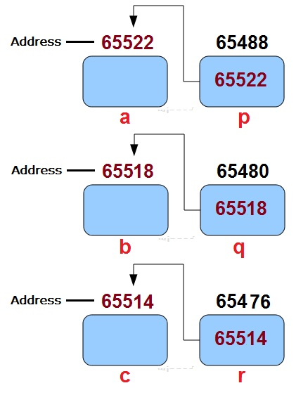
Suppose we have float type variable
    float a, b, c ;
    in which address of
    a is 65522
    b is 65518
    c is 65514
    p-q => (65522 – 65518) / 4 => Literal Subtraction / Sizeof (typeof pointer) = > 1
    p-r => (65522 – 65514) / 4 => Literal Subtraction / Sizeof (typeof pointer) => 2
    p-q => (65514 – 65522) / 4 => Literal Subtraction / Sizeof (typeof pointer) => -2

Slide 134
Application of Pointer in C
In Function using Call by address.
In an Array ( we can print scan value through pointer)
In Dynamic Memroy Alloation

Slide 135
What is Wild Pointer
  void main()
  {
  int *p ;
  printf(“%u” , p);
  // uninitialize pointer or called wild pointer
  //print garbage value which means garbage address of any location
  *p=4
  //4 store an unknown location or invalid location (free memory area)
  }

Slide 136
What is NULL Pointer
  Pointer which consist NULL value called NULL Pointer.
  NULL is Predefined MACRO.
  NULL assign means, pointer hold address 0 which also free memory area but we assume that they does not point to any space in memory.
  int *p= NULL ;
  It is a Solution for Wild Pointer Problem
  Remember:
  Valid Address are the reserved addresses in Memory by you for your requirment in your Program.

Slide 137
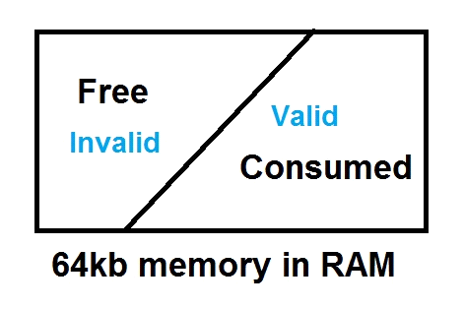
Dangling Pointer

Slide 138
Dangling Pointer
  When a program is hold invalid address which before a Valid address in a program. Or when pointer hold the valid address which convert into invalid address

Slide 139
What is Dangling Pointer in C language
    void fun(void);
    main()
    {
    fun();
    }
    void fun()
    {
    int *p;
    {
    int x=5;
    p=&x;
    .........
    .........
    } // After this block is end , p point invalid address ( address of x)
    }

Slide 140
Solution For Dangling
After use of pointer , assign NULL value in that pointer in current scope
NULL is Predefined MACRO.
NULL assign means, pointer hold address 0 which also free memory area but we assume that they does not point to any space in memory.

Slide 141
What is void Pointer Or Generic Pointer
    void main()
    {
    void *p ;
    int x ;
    p=&x;
    *(int*)p = 10 ; //type casting is necessary
    printf ( “Address is %u and Value at that address is %d” , p , *(int*)p );
    }

Slide 142
Continue…
void main()
{
void *p ;
float x ;
p=&x;
*(float*)p = 10 ; //type casting is necessary
printf ( “Address is %u and Value at that address is %f” , p , *(float*)p );
}

Slide 143
Functions
Objective
What is Function ?
Defination Declaration and Call
Declaration
Ways to Define a function
Formal and Actual Arguments
Types of formal arguments
Call by value, call by address and call by reference

Slide 144
What is Function ?
  Function is block of code performing a unit task.
  Function has a name, return type and argument( argument depend on fun behavior)
  Function is a way to achieve modularization
  Functions are predefined and user-defined.
  Predefined function are declared in header files and defined in library files.

Slide 145
Defination Declaration and Call
    #include<stdio.h> //Declaration of printf() , scanf ()
    #include<conio.h> // Declaration of clrscr() and getch()
    //void fun(void); //Global function Declaration
    void main()
    {
    clrscr();
    void fun(void); //local function declaration
    printf(”You are in main”);
    fun();
    getch();
    }
    void fun()
    {
    printf(”You are in fun”);
    }

Slide 146
Declaration
Function Declaration is also known as function prototype.
Function need to be declared before use (Just like variable)
Function can be declare locally or globally
Return type function_name(argument_list);
Function Defination is a block of code.

Slide 147
Ways to define a function ?
Takes Nothing, Return Nothing
Takes Something, Return Nothing
Takes Nothing, Return Something
Takes Something, Return Something
Note:
main() function can be define in above 4 Ways if we run our program through cmd. We can pass argument to the main(). But if we use double click for running the program then better way is to make main() as Takes nothing return nothing.

Slide 148
Types of formal arguments
Formal arguments can be of three types
Ordinary variable
Pointer Variable

Slide 149
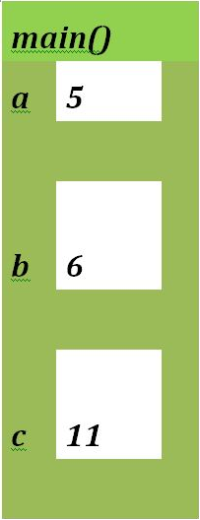
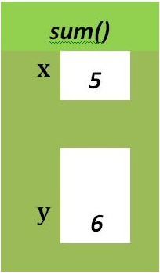
Formal and Actual Arguments
    include<stdio.h>
    int sum(int, int);
    void main()
    {
    int a=5, b=6;
    int c=sum(a,b);
    // a and b are actual arguments
    printf(” sum is %d “ ,c );
    }
    int sum (int x, int y)
    // x and y are formal arguments
    {
    return(x+y);
    }

Slide 150
Ordinary Variable as formal arguments
Call by value:
When formal arguments are ordinary variables,it is function call by value

Slide 151
    Example:
    #include<stdio.h>
    int sum(int, int);
    void main()
    {
    int a=5, b=6;
    int s= sum(a,b);
    printf(“sum is %d” , s) ;
    }
    int sum(int x, int y)
    {
    return (x+y);
    }

Slide 152
Pointer Variable as formal arguments
Call by address :
When passing arguments are the address of actual arguments and formal arguments are pointer variables, it is function call by address

Slide 153
    Example:
    #include<stdio.h>
    #include<conio.h>
    int sum(int*, int*);
    void main()
    {
    int a=5, b=6
    int s= sum(&a,&b);
    printf( “sum is %d” , s );
    }
    int sum(int *x, int *y)
    {
    return (*x+*y);
    }

Slide 154
Storage Classes in C++
  Storage classes are used to specify the lifetime and scope of variables. How storage is allocated for variables and How variable is treated by complier depends on these storage classes.

Slide 155
These are basically divided into 5 different types :
  Global variables
  Local variables
  Register variables
  Static variables
  Extern variables

Slide 156
Global variables
  These are defined at the starting , before all function bodies and are available throughout the program.
  Example :
  using namespace std;
  int globe; // Global variable
  void func();
  int main()
  {
  .....
  }
  Note : Default value of such variable is 0

Slide 157
Local variables
  They are defined and are available within a particular scope. They are also called Automatic variable because they come into being when scope is entered and automatically go away when the scope ends.
  The keyword auto is used, but by default all local variables are auto, so we don't have to explicitly add keyword auto before variable dedaration. Default value of such variable is garbage.
  Note : Default value of such variable is garbage.

Slide 158
Register variables
  This is also a type of local variable. This variable are stored in register instead of RAM
  As variable is stored in register, the maximum size of variable= Max size of Register.
  Unary operator [&] is not associated withit because value is not stored in RAM instead it is stored in Register.
  This is generally used for faster access.
  A register variable can be declared only within a block, that means, you cannot have global or static register variables.
  Note: Default value of such variable is garbage.

Slide 159
Example :
  #include<iostream.h>
  #include<conio.h>
  void main()
  {
  float a,b;
  register c; //register float c; (Default is int)
  clrscr();
  c=a+b;
  cout<<"Enter two number \n";
  cin>>a>>b;
  c=a+b;
  cout<<"Sum of two number is "<<c<<endl;
  cout<<"size of c is"<<sizeof(c);
  /*Return size of reference of register variable which is made in RAM */
  getch();
  }
  Note: It is not applicable for arrays, structures or pointers.

Slide 160
Static variables
  Static variables are the variables which are initialized & allocated storage only once at the beginning of program execution, no matter how many times they are used and called in the program. A static variable retains its value until the end of program.
  void fun()
  {
  static int i = 10;
  i++;
  cout << i;
  }
  void main()
  {
  fun(); // Output = 11
  fun(); // Output = 12
  fun(); // Output = 13
  }
  As, i is static, hence it will retain its value through function calls, and is initialized only once at the beginning.
  Static specifiers are also used in classes, but that we will learn later.
  Note: Don’t confused with static and const keyword

Slide 161
Extern Variable
a) extern variable
  The variable that are available to all the function i.e, from entire program they can be accessed, this variable are called external or global variables.
  External variables are eclared outside the function body. In case both external and auto variables are declared with the same name in a program, the first priority is given to the auto variable. In this case external variable is hidden.

Slide 162
Example:
  Program which show the working of auto and extern/global variable with same name.
    #include<iostream.h>
    #include<conio.h>
    void fun1();
    void fun2();
    int v=10;
    void main()
    {
    fun1();
    fun2();
    cout<<"In main() v= "<<v<<endl;
    getch();
    }
    void fun1()
    {
    int v=20; // Try extern int v=20;
    cout<<"In fun() v= "<<v<<endl;
    }
    void fun2()
    {
    cout<<"In fun() v= "<<v<<endl;
    }
    Output :
    In fun1 v= 20
    In fun1 v= 10
    In fun1 v= 10

Slide 163
Continue…
b)extern variable
  With the help of extern keyword we can declare global variable in a bottom of global variable in outside function body in c programs.
    #include<iostream.h>
    #include<conio.h>
    void fun1();
    void fun2();
    void main()
    {
    extern v;
    fun1();
    cout<<"In main() v= "<<v<<endl;
    fun2();
    getch();
    }
    void fun1()
    {
    extern v;
    v=20;
    cout<<"In fun1() v= "<<v<<endl;
    }
    void fun2()
    {
    extern v;
    cout<<"In fun()2 v= "<<v<<endl;
    }
    int v=10;

Slide 164
continue….
C ) extern variable
  This keyword is used to access variable in a file which is declared & defined in some other file, that is the existence of a global variable in one file is declared using extern keyword in another file.

Slide 165
Example :
main.cpp
    #include<iostream.h>
    #include<conio.h>
    #include"external.cpp"
    int num=100;
    void main()
    {
    clrscr();
    cout<<" num before calling fun() function in Main "<<num<<endl;
    fun();
    cout<<" num after calling fun() function in Main "<<num<<endl;
    getch();
    }
external.cpp
    #include<iostream.h>
    #include<conio.h>
    void fun();
    void fun()
    {
    extern num;
    num=100+200; //change made in global variable
    cout<<"num in fun function of external file is: "<<num<<endl;
    }
    O/P : num before calling fun() function in Main 300
    num in fun function of external file is:
    num after calling fun() function in Main 300

Slide 166
sizeof and typedef in c++
a) sizeof operator
  sizeOf is also an operator not a function, it is used to get information about the amount of memory allocated for data types & Objects. It can be used to get size of user defined data types too.
  sizeOf operator can be used with and without parentheses. If you apply it to a variable you can use it without parentheses.
EXAMPLE :
cout << sizeOf(double); //Will print size of double
int x = 2;
int i = sizeOf x;

Slide 167
b) typedef Operator
  a) typedef is a keyword used in C/C++ language to assign alternative names to existing types. Its mostly used with user defined data types, when names of data types get slightly complicated.
Syntax :
typedef existing_name alias_name
Example:
typedef unsigned long ulong;
ulong i, j;

Slide 168
Continue
b) typedef and Pointers
  typedef can be used to give an alias name to pointers also. Here we have a case in which use of typedef is beneficial during pointer declaration.
  In Pointers * binds to the right and not the left.
  int *x ,y ;
  By this declaration statement, we are actually declaring x as a pointer of type int, whereas y will be declared as a plain integer.
  typedef int* intPtr ;
  intPtr x, y, z;
  Note:
  With the help of typedef in pointer, we can declare any number of pointers in a single statement.

